Slide 1


Enron Americas
Power Trading
Audit Report
September 25, 2001
Confidential
Enron Assurance Services

Slide 2
Power Trading Audit
Project Objective (East and West):
Our review was designed to identify and test key policies, procedures, and controls related to 1) critical business processes (capture, documentation, confirmation, reporting and accounting), 2) adequate identification of key risks (i.e. ancillary services, transmission, Financial Transmission Rights (FTR)), 3) adequate information to support changes in portfolio valuations (i.e., curve adjustments), 4) adequate interface controls and validation checks within EnPower, 5) proper calculation and reporting of portfolio results, 6) monitoring of long-term and requirements basis deals, 7) proper accounting for portfolio under accrual or mark-to-market accounting, 8) adequate controls over ISO activity and infrastructure, and 9) proper involvement of the legal group in creation of contracts and standard confirmation templates.
AA Team Members: Enron Team Members:
Tom Bauer Michael Schultz Stacey White Georganne Hodges Steve Nat
Jennifer Stevenson Russell Bouwhuis Lloyd Will Leslie Reeves Duong Luu
Mark Meador Sean Sipko Tom May Todd Warwick Sanjay Gupta
Jennifer Muse Bethany Denson Theresa Allen Tracy Irvin David Poston
Tatiana Waxler Kim Theriot Melissa Ratnala Bill Hare Jennifer Staton Murray O’Neil Casey Evans Tim Belden
Corry Bentley Donnie Vinson Chris Calger
Elizabeth Sager Melissa Murphy Frank Hayden Marilyn Tisdale
Enron Assurance Services
2

Slide 3
Power Trading Audit
Current Portfolio
East Power
The longest term deal in the portfolio is a forward sale to United Illuminating with the term extending until July 2015.
The portfolio contains 5 requirements deals, including one deal in the newly-emerging Ercot market.
The portfolio currently has various Transmission Congestion Contracts (TCC) which were awarded in different auctions. The longest contract extends through October 2005.
The portfolio has 1 long-term transmission deal which extends through September 2001 and various other short-term transmission deals.
East Power
June 30, 2001
NOP <15.3> MMWh
YTD P&L $398 MM
*DEAL TEST - Tested 13 deals ( 7 EOL Deals )
3

Slide 4
Power Trading Audit
Current Portfolio
West Power
The Portland office is comprised of approximately 100 employees, which includes commercial and commercial-support personnel.
Enron Power Marketing, Inc. (EPMI) performs scheduling activity with the California ISO on behalf of 16 third parties, compared to 10 in 1999.
The longest term deal in the portfolio is a forward sale to Powerex Corp extending until October 2014.
Confirmation and settlement processes are performed in Houston.
There is 1 transmission deal in the portfolio that extends through September 2001.
Two Credit Risk Management resources are available in the Portland office.
West Power
June 30, 2001
NOP <7.4> MMWh
YTD P&L $613 MM
*DEAL TEST - Consisted of 7 deals (0 EOL Deals)
4

Slide 5
Power Trading Audit
Deal Test Summary
Tested 20 Power Deals
Attributes tested
Deal Capture
  Deal executed by an authorized trader
  Complete deal ticket
  Deal correctly captured in EnPower
  Counterparty set-up in Global Counterparty
Documentation
  Timely confirmation procedure
  Executed contract and/or confirmation
  Contract, confirmation and deal ticket agree
  Confirmation signed by authorized personnel
  Proper confirmation status in DCAF
  Broker confirm agrees to deal ticket
Valuation
  Proper curve utilized to value deal
  Proper bridge of deal terms into the valuation engine
Summary of key deal test findings
Two “day-ahead” deals were not entered into the system in a timely manner. These deals were both pool deals (one with the NY ISO and one with NePool) entered into by the scheduling group. As these deals are index deals, there was no impact to new deal value.
For one EOL deal, the confirmation was not signed by the counterparty. Legal is currently amending master contracts to allow for no confirmation of EOL deals.
One deal was executed by a trader not included on the authorized trader list. The authorized trader list should be updated in a timely manner to reflect all traders and schedulers that are authorized to trade.
Deal Test Timeline
Review of deals executed throughout the year. Additional testing to be performed in September/ October timeframe.
5

Slide 6
Power Trading Audit
High Priority Items
Enron Assurance Services
6

Slide 7
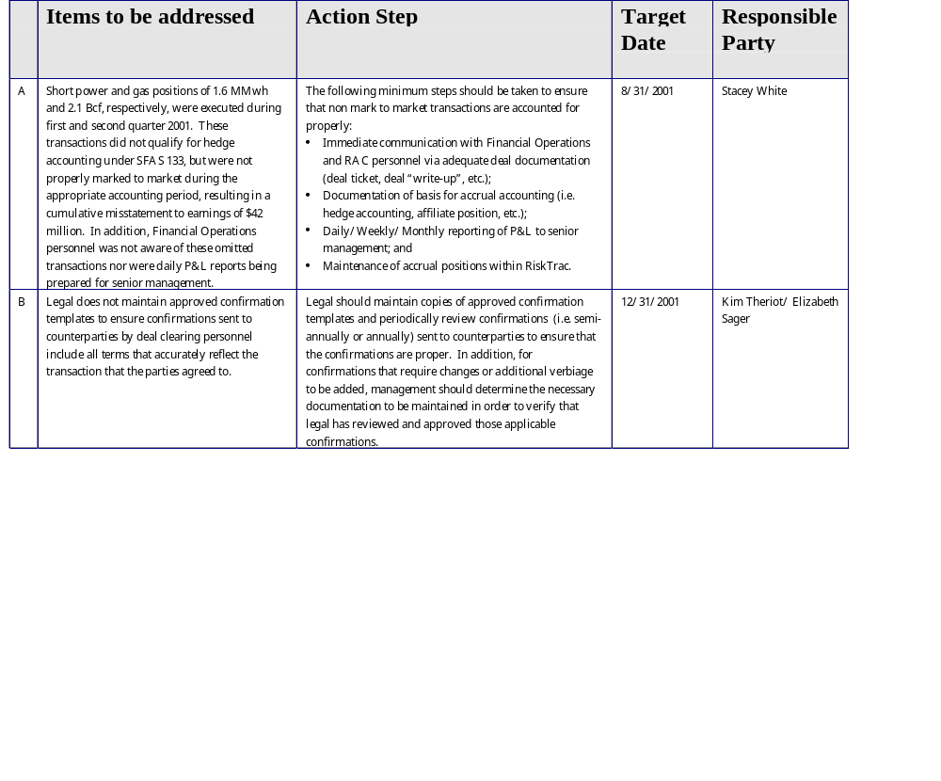
Power Trading Audit Observations
High Priority
Enron Assurance Services
7

Slide 8
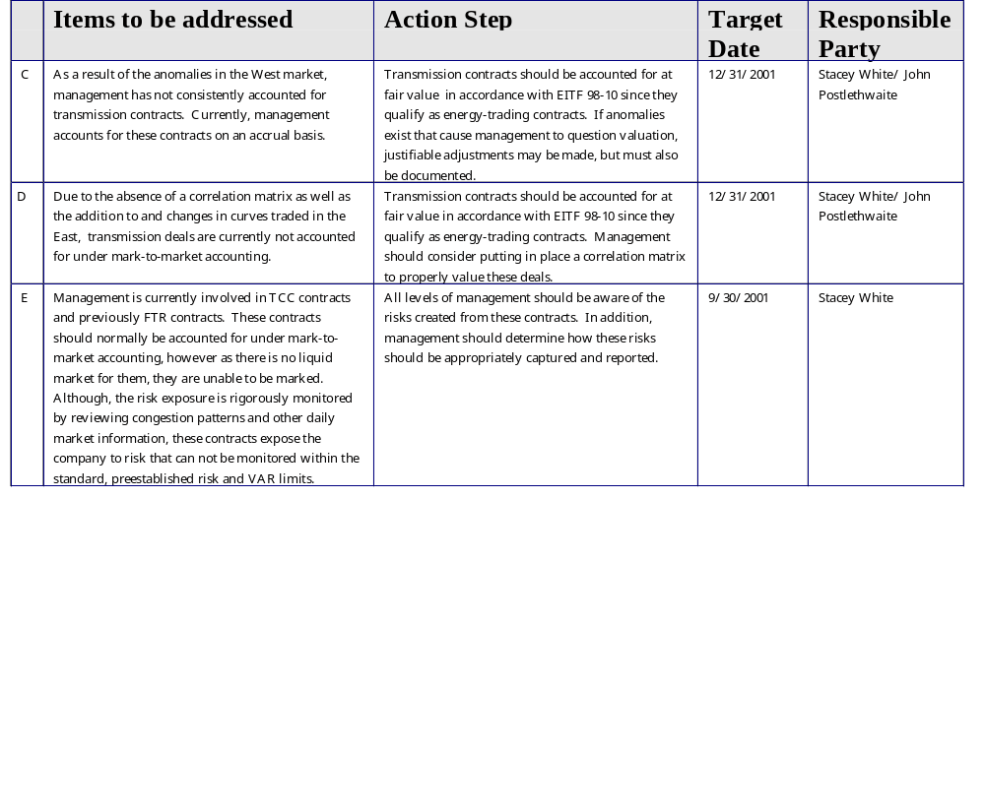
Power Trading Audit Observations
High Priority
8
Enron Assurance Services

Slide 9
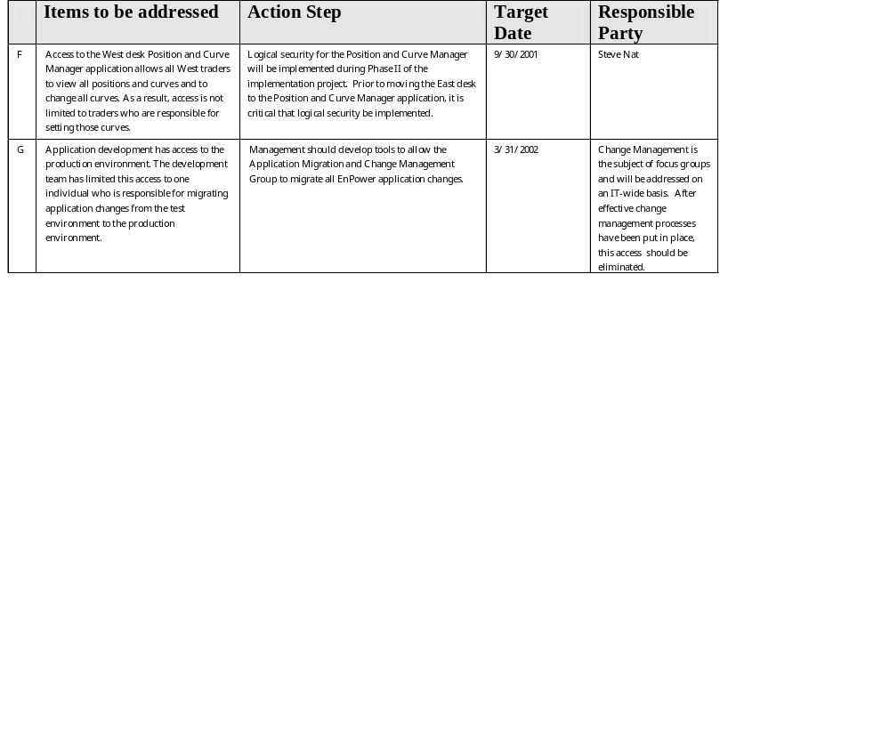
Power Trading Audit Observations
High Priority
9
Enron Assurance Services

Slide 10
Power Trading Audit
Low Priority Items
10
Enron Assurance Services

Slide 11
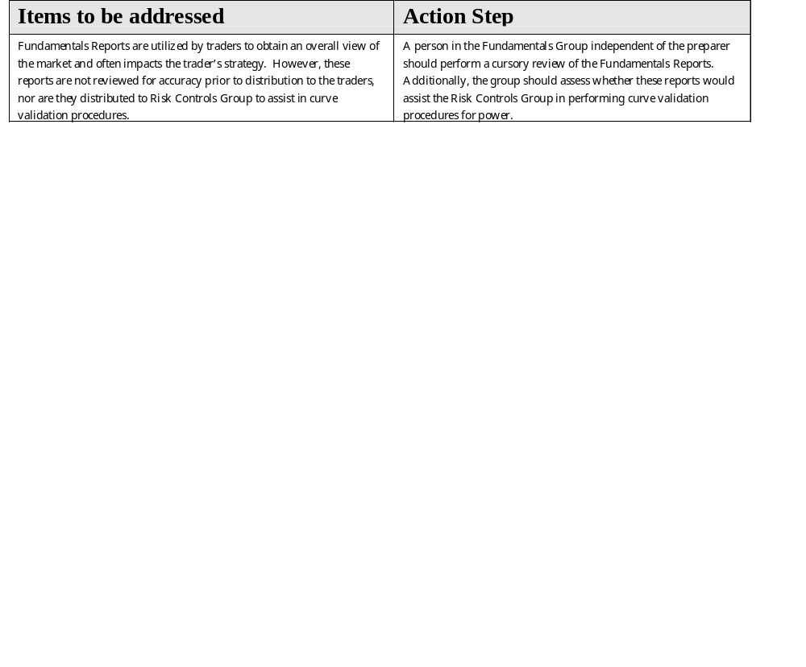
Power Trading Audit Observations
Low Priority
11
Enron Assurance Services

